Slide 1
Unit -6
Rapid Prototyping

Slide 2
Content
Classification of RPT systems
Process chain
3D modelling
Data conversion
Checking-building- postprocessing
Stereolithography (STL)-process, principle, CAD for RPT
Creation of STL file from 3D solid models

Slide 3
Classification of RPT systems
RPT systems
Liquid Based
Powder Based
Solid Based

Slide 4
Liquid-Based Rapid Prototyping
Liquid-based RP systems have initial form of its material in liquid state. Through a process commonly known as curing, the liquid is converted to the solid state. The following RP systems fall into this category:
3D Systems' Stereolithography Apparatus (SLA)
Cubital's Solid Ground Curing (SGC)
Sony's Solid Creation System (SCS)
CMET’s Solid Object Ultraviolet-laser Printer (SOUP)
Autostrade’s E-Darts
Teijin Seiki’s Soliform System
Meiko's Rapid Prototyping System for the Jewelry Industry
Denken’s SLP
Mitsui's COLAMM
Fockele & Schwarze’s LMS
Light Sculpting
Rapid Freeze
Two Laser Beams
Microfabrication
Aaroflex

Slide 5
Solid Based
Solid-based RP systems are meant to encompass all forms of material in the solid state. In this context, the solid form can include the shape in the form of a wire, a roll, laminates and pellets.
Cubic Technologies’ Laminated Object Manufacturing (LOM)
Stratasys’ Fused Deposition Modeling (FDM)
Kira Corporation’s Paper Lamination Technology (PLT)
3D Systems’ Multi-Jet Modeling System (MJM)
Solidscape’s ModelMaker and PatternMaster
Beijing Yinhua’s Slicing Solid Manufacturing (SSM), Melted Extrusion Modeling (MEM) and Multi-Functional RPM Systems (M-RPM)
CAM-LEM’s CL 100
Ennex Corporation’s Offset Fabbers

Slide 6
Powder Based
Powder is by-and-large in the solid state. However, it is intentionally created as a category outside the solid-based RP systems to mean powder in grain-like form
3D Systems’s Selective Laser Sintering (SLS)
EOS’s EOSINT Systems
Z Corporation’s Three-Dimensional Printing (3DP)
Optomec’s Laser Engineered Net Shaping (LENS)
Soligen’s Direct Shell Production Casting (DSPC)
Fraunhofer’s Multiphase Jet Solidification (MJS)
Acram’s Electron Beam Melting (EBM)
Aeromet Corporation’s Lasform Technology
Precision Optical Manufacturing’s Direct Metal Deposition (DMDTM)
Generis’ RP Systems (GS)
Therics Inc.’s Theriform Technology
Extrude Hone’s Prometal TM 3D Printing Process

Slide 7
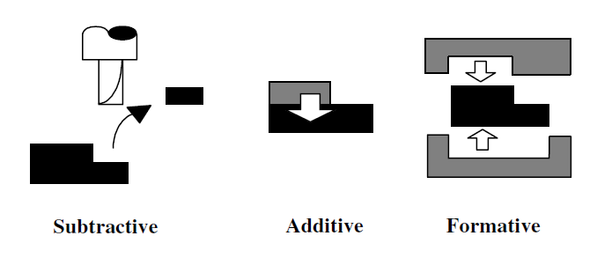
Fundamental Fabrication Processes

Slide 8
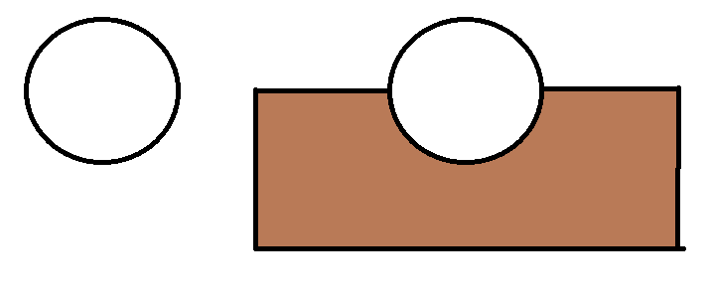
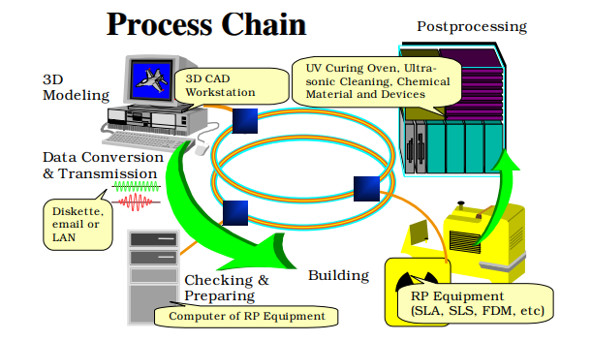
Process Chain
5 steps of process chain:
3D modeling,
data conversion and transmission,
checking and preparing,
Building
and postprocessing.
Data transmission via agreed data formats
such as STL or IGES may be carried out through
a diskette,
email
(electronic mail)
or LAN (local area network).

Slide 9
Stereolithography (STL)-process, principle, CAD for RPT
The SLA process is based fundamentally on the following principles
Parts are built from a photo-curable liquid resin (It often starts as a liquid and cures into a solid form when exposed to light) that cures when exposed to a laser beam which scans across the surface of the resin.
The building is done layer by layer, each layer being scanned by the optical scanning system and controlled by an elevation mechanism which lowers at the completion of each layer

Slide 10
Terms
Photopolymerization : Polymerization is the process of linking small molecules (known as monomers) into chain-like larger molecules (known as polymers). When the chain-like polymers are linked further to one another, a cross-linked polymer is said to be formed. Photopolymerization is polymerization initiated by a photochemical process whereby the starting point is usually the induction of energy from the radiation source.
Photopolymers : The term photopolymer refers to a class of light-sensitive resins that solidify when exposed to ultraviolet (UV) light. When the liquid photopolymer resin comes into contact with a UV light source — typically a lamp, laser, or projector — photoinitiators transform that light energy into chemical energy. Then, oligomers or “binders” and monomers combine, harden, and form bonds that create the polymer structure. Photopolymers are either thermoplastics, which melt at high temperature, thermosets, meaning they can’t be melted or reshaped once cured by heat.

Slide 11
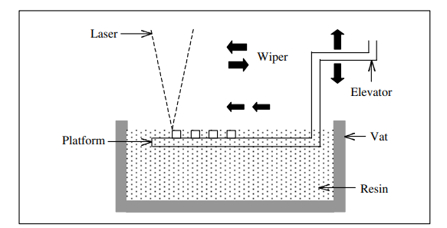
Process

Slide 12


Slide 13
Thanks

